Slide 1
Chicago Crime
By: Trever Alexander & Jiahao Deng
Notes:
Trever

Slide 2
Proposed Questions
What are the most common crimes in Chicago?
What are the top violent crimes in Chicago?
What are the top locations for crimes in Chicago?
How are crimes affected by the proximity of police stations?
How have crimes changed over a period of time?
Notes:
Trever

Slide 3
Overview
Retrieved two datasets Chicago Crimes & Chicago Police Station
Data Cleaning
Dataset contained over 6 million rows of data so we decided to subset the last 5 years
Removed rows with missing values
Removed outliers in crime dataset (values that fell outside the Chicago region)
Data Analysis
Notes:
Jiahao

Slide 4
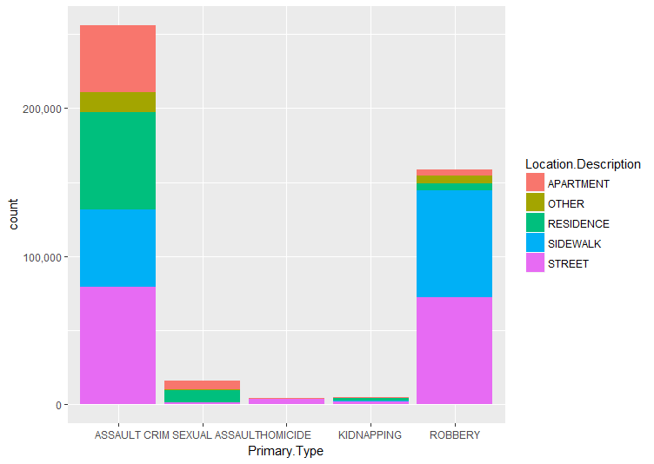
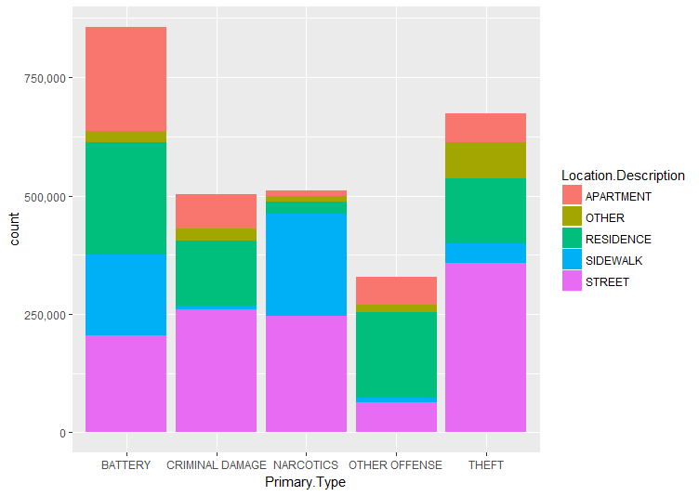
Crimes & Location
Notes:
Trever

Slide 5
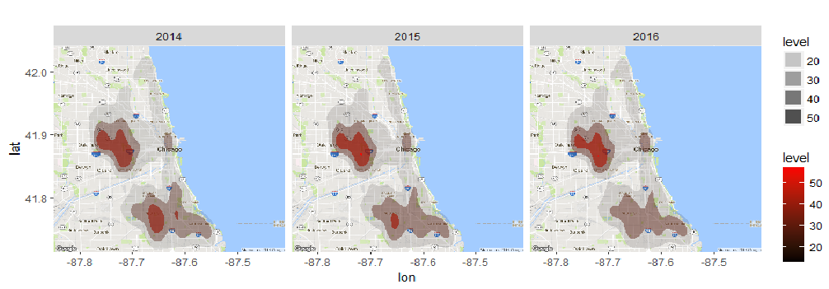
Geographic analysis
Notes:
Trever

Slide 6
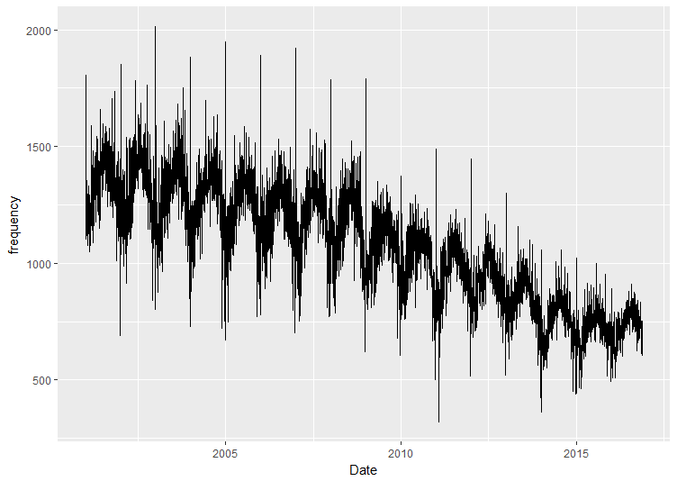
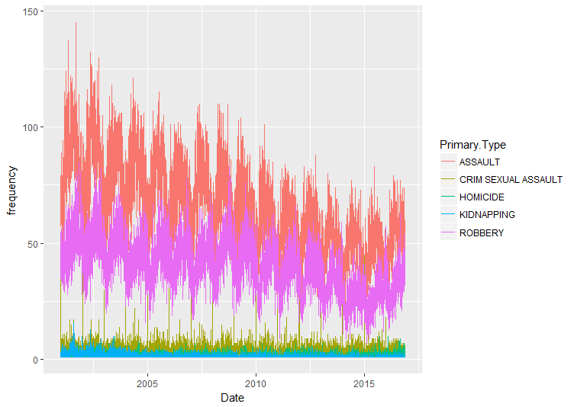
Time series
Notes:
Jiahao

Slide 7
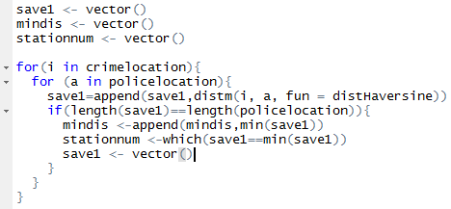
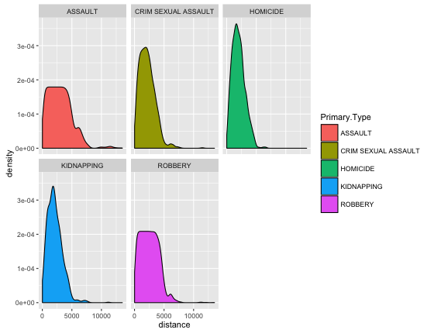
Crimes vs Police Station Proximity
Link the crime location to the nearest police station
Notes:
Jiahao

Slide 8
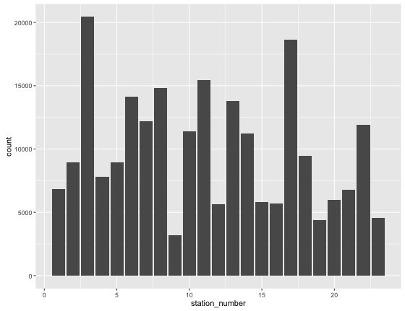
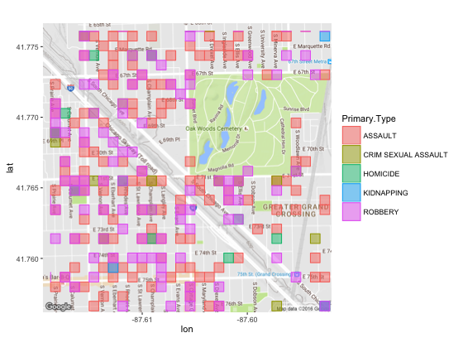
Crimes vs Police Cont.

Slide 9
Final Thoughts
Homicide has remained constant over the years
Overall crimes have been decreasing over the years
Assault and Robbery are the only crimes increasing
Heightened security or hire more officers around station 3 & 17 because these two area's are experiencing the most crime.
Notes:
Trever

